Slide 1



Machine Learning LAB
Week 04

Slide 2
Topics to cover
KNN
SVM
Voting Classifier

Slide 3
KNN
import matplotlib.pyplot as plt
from sklearn.datasets import load_wine
from sklearn.model_selection import train_test_split
from sklearn.neighbors import KNeighborsClassifier
from sklearn.metrics import accuracy_score

Slide 4
KNN
# Load the Wine dataset
wine = load_wine()
X, y = wine.data, wine.target
# Split the data into training and test sets
X_train, X_test, y_train, y_test = train_test_split(X, y, test_size=0.2)

Slide 5
KNN for different values
# Define the k values to test
k_values = [1, 3, 5, 7, 9]
# Train a KNN classifier for each value of k and record the accuracy scores
accuracy_scores = []
for k in k_values:
knn = KNeighborsClassifier(n_neighbors=k)
knn.fit(X_train, y_train)
accuracy = knn.score(X_test, y_test)
accuracy_scores.append(accuracy)

Slide 6
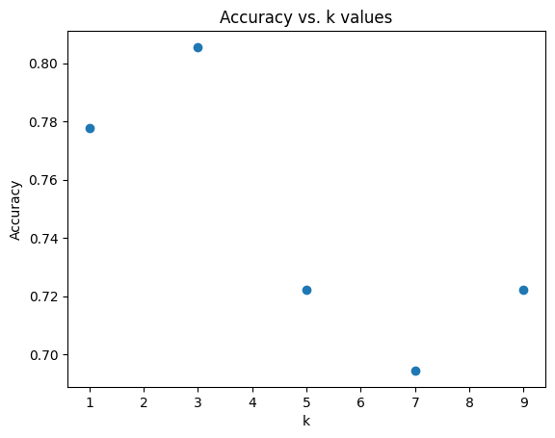
KNN for different values
# Plot accuracy against k values
plt.scatter(k_values, accuracy_scores)
plt.xlabel("k")
plt.ylabel("Accuracy")
plt.title("Accuracy vs. k values")
plt.show()

Slide 7

KNN for different values
k_values = range(1, 30)
accuracy_scores = []
# Apply KNN for different values of k
for k in k_values:
knn = KNeighborsClassifier(n_neighbors=k)
knn.fit(X_train, y_train)
y_pred = knn.predict(X_test)
accuracy = accuracy_score(y_test, y_pred)
accuracy_scores.append(accuracy) # Print the best value of k
best_k = k_values[accuracy_scores.index(max(accuracy_scores))]
print("Best value of k:", best_k)

Slide 8
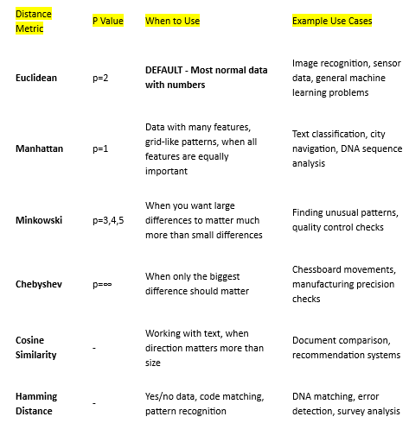
Change p values
import matplotlib.pyplot as plt
from sklearn.datasets import load_wine
from sklearn.model_selection import train_test_split
from sklearn.neighbors import KNeighborsClassifier
from sklearn.metrics import accuracy_score # Load the Wine dataset
wine = load_wine()
X, y = wine.data, wine.target # Split the data into training and test sets
X_train, X_test, y_train, y_test = train_test_split(X, y, test_size=0.2, random_state=42)

Slide 9
Change p values
# Define the p values to test
p_values = [1, 2, 3, 4, 5] # Train a KNN classifier for each value of p and record the accuracy scores
accuracy_scores = []
for p in p_values:
knn = KNeighborsClassifier(n_neighbors=5, p=p) # Adjust n_neighbors as needed
knn.fit(X_train, y_train)
y_pred = knn.predict(X_test)
accuracy = accuracy_score(y_test, y_pred)
accuracy_scores.append(accuracy)

Slide 10
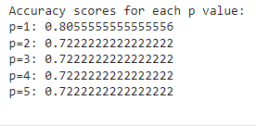
Change p values
# Print the accuracy scores for each p value
print("Accuracy scores for each p value:")
for p, accuracy in zip(p_values, accuracy_scores):
print(f"p={p}: {accuracy}")
print()

Slide 11
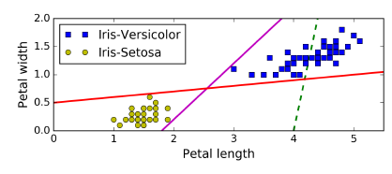
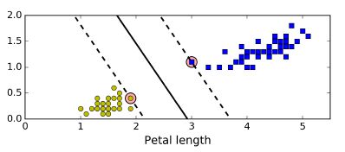
SVM
A Support Vector Machine (SVM) is a very powerful and versatile Machine Learning model, capable of performing linear or nonlinear classification, regression, and even outlier detection
You can think of an SVM classifier as fitting the widest possible street (represented by the parallel dashed lines) between the classes.
This is called large margin classification

Slide 12
SVM
Notice that adding more training instances “off the street” will not affect the decision boundary at all: it is fully determined (or “supported”) by the instances located on the
edge of the street. These instances are called the support vectors

Slide 13
SVM
# Import all relevant libraries
from sklearn.svm import SVC
import numpy as np
import pandas as pd
from sklearn.preprocessing import StandardScaler
from sklearn.model_selection import train_test_split
from sklearn.metrics import accuracy_score, confusion_matrix
from sklearn import preprocessing
from sklearn.model_selection import train_test_split, cross_val_score
import warnings
warnings.filterwarnings("ignore")

Slide 14
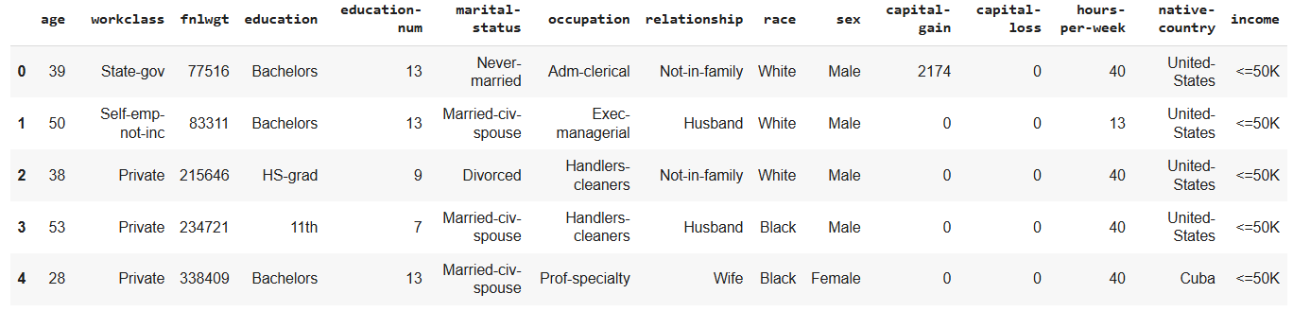
SVM
df = pd.read_csv('/content/income_evaluation.csv')
df.head()

Slide 15
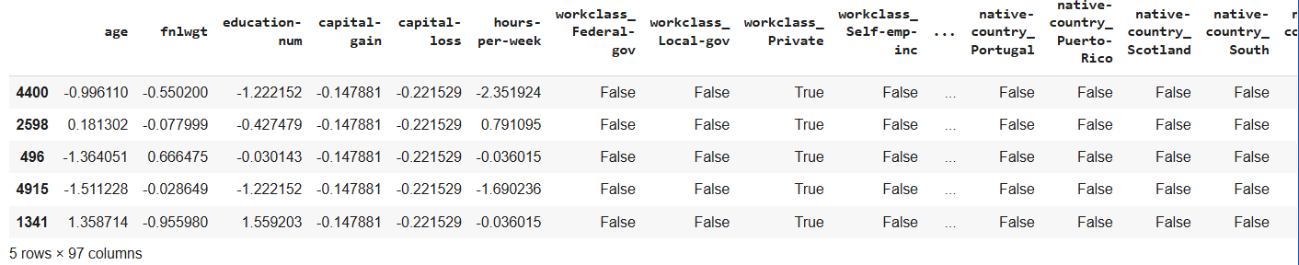
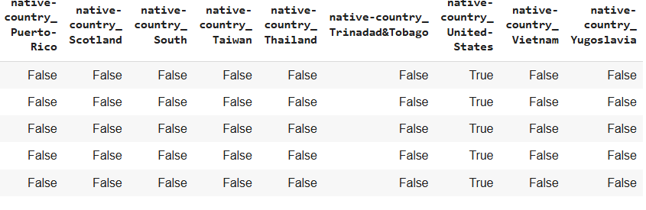
SVM
# Identify categorical and numerical features
categorical_features = df.select_dtypes(include=['object']).columns
numerical_features = df.select_dtypes(exclude=['object']).columns
# Apply one-hot encoding to categorical features
df = pd.get_dummies(df, columns=categorical_features, drop_first=True)
# Separate features and target variable again after one-hot encoding
X = df.drop("income_ >50K", axis=1) # Adjust target column name based on get_dummies output
y = df["income_ >50K"]
# Split data into training and testing sets
X_train, X_test, y_train, y_test = train_test_split(X, y, test_size=0.2, random_state=101)
# Scale numerical features
scaler = StandardScaler()
X_train[numerical_features] = scaler.fit_transform(X_train[numerical_features])
X_test[numerical_features] = scaler.transform(X_test[numerical_features])
display(X_train.head())

Slide 16

SVM
svc = SVC(random_state=101)
svc.fit(X_train,y_train)
accuracies = cross_val_score(svc,X_train,y_train,cv=5)
print("Train Score:", np.mean(accuracies))
print("Test Score:", svc.score(X_test,y_test))

Slide 17
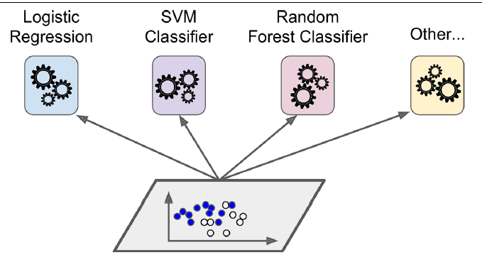
Voting Classifiers
Suppose you have trained a few classifiers, each one achieving about 80% accuracy. You may have a Logistic Regression classifier, an SVM classifier, a Random Forest classifier, a K-Nearest Neighbors classifier, and perhaps a few more

Slide 18
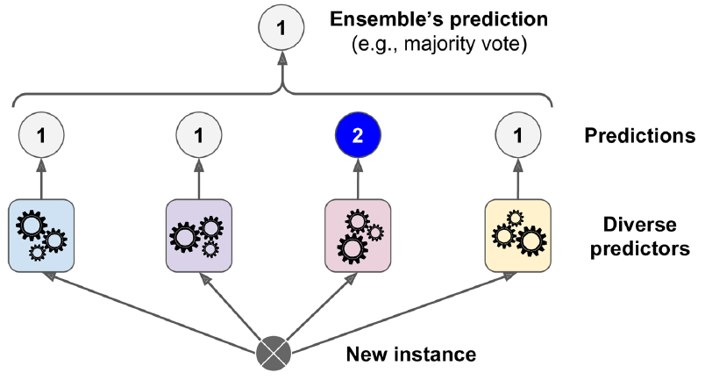
Voting Classifiers
A very simple way to create an even better classifier is to aggregate the predictions of each classifier and predict the class that gets the most votes. This majority-vote classifier is called a hard voting classifier

Slide 19
Voting Classifiers
from sklearn.ensemble import RandomForestClassifier
from sklearn.ensemble import VotingClassifier
from sklearn.linear_model import LogisticRegression
from sklearn.svm import SVC
log_clf = LogisticRegression()
rnd_clf = RandomForestClassifier()
svm_clf = SVC()
voting_clf = VotingClassifier(
estimators=[('lr', log_clf), ('rf', rnd_clf), ('svc', svm_clf)], voting='hard’ )
voting_clf.fit(X_train, y_train)
print(voting_clf.predict([some_digit]))

Slide 20

Voting Classifiers
from sklearn.metrics import accuracy_score
for clf in (log_clf, rnd_clf, svm_clf, voting_clf):
clf.fit(X_train, y_train)
y_pred = clf.predict(X_test)
print(clf.__class__.__name__, accuracy_score(y_test, y_pred))

Slide 21
Activity 1
KNN for Credit Card Fraud Detection
Data Set: https://www.kaggle.com/datasets/mlg-ulb/creditcardfraud?resource=download
Use KNN to detect fraudulent transactions in a highly imbalanced dataset, where frauds make up less than 0.2% of all samples.
Load the dataset and split it into features X and target y.
Apply SMOTE (Synthetic Minority Oversampling Technique) or ADASYN to handle class imbalance.
Scale features using StandardScaler.
Train a KNN classifier with k=5, then tune k using GridSearchCV for best results.
Compare model performance using:
Accuracy
F1-Score

Slide 22
Activity 2
SVM for Brain Tumor Detection
Data Set: https://www.kaggle.com/datasets/navoneel/brain-mri-images-for-brain-tumor-detection
Load the dataset and preprocess all MRI images:
Convert to grayscale
Resize to 64×64
Flatten each image
Split data into training and testing sets (80:20).
Normalize features using StandardScaler().
Train an SVM
Evaluate performance using accuracy, classification report, and confusion matrix.
Display a few test images with predicted and actual labels.

